Slide 1

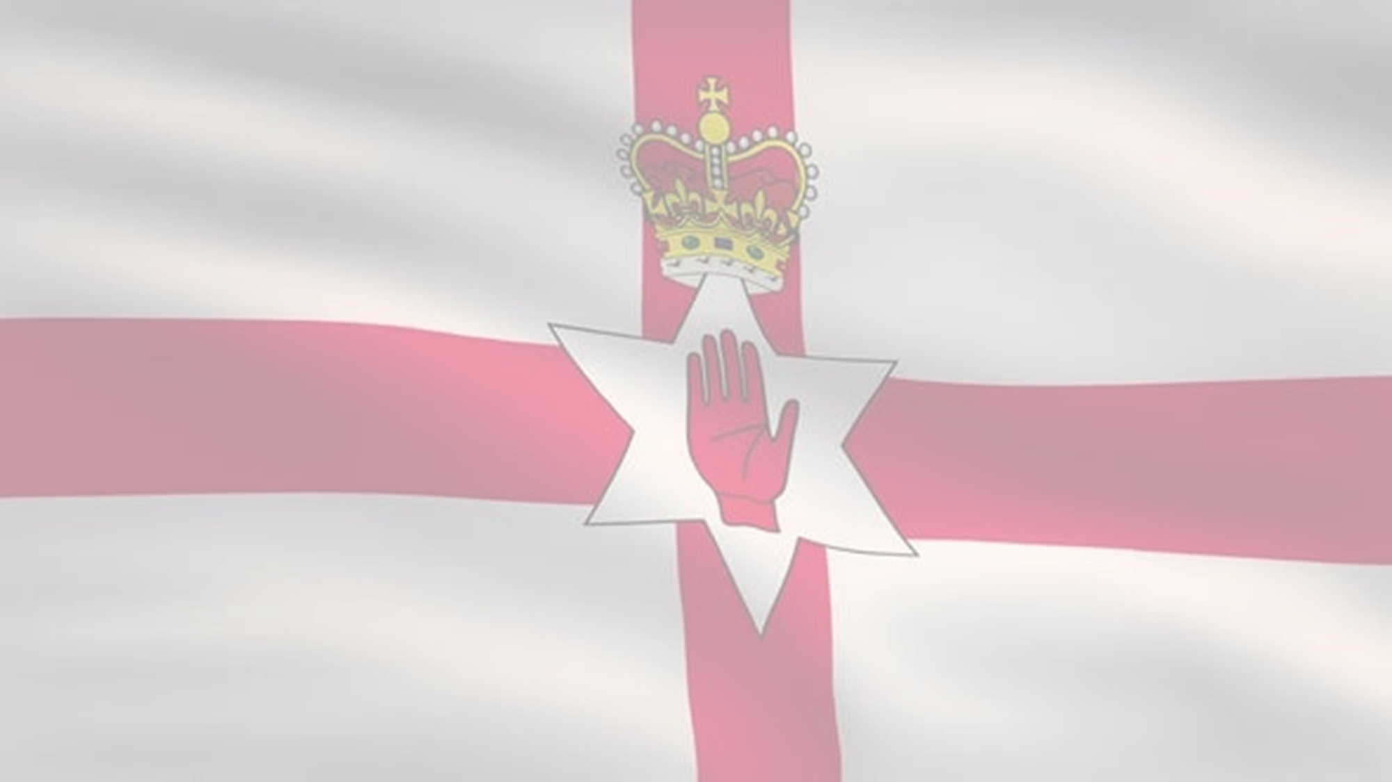





1920-2007
Chapter 30
NORTHERN IRELAND AND THE TROUBLES
northern ireland and the troubles
Strand Two: The History of Ireland
@MsDoorley

Slide 2
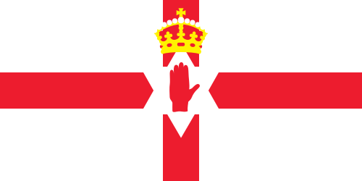
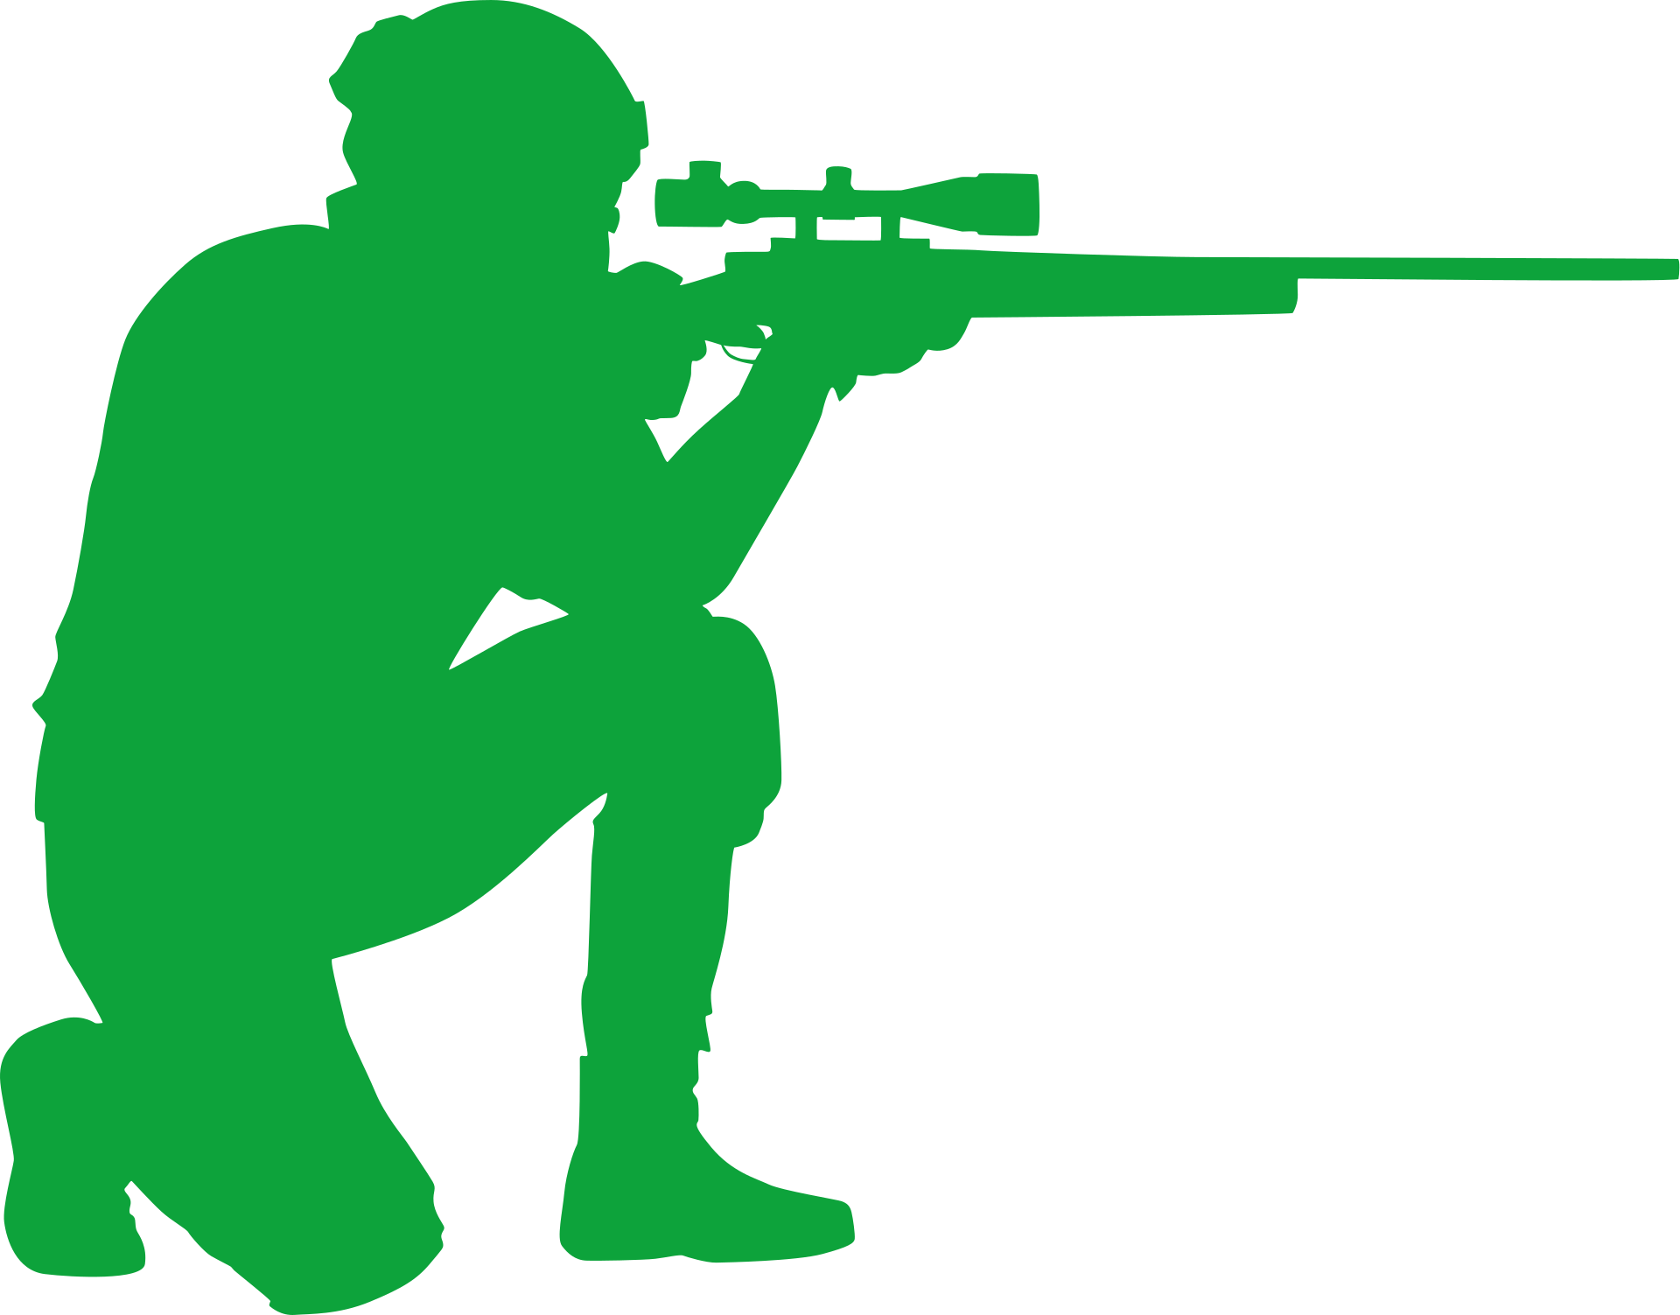
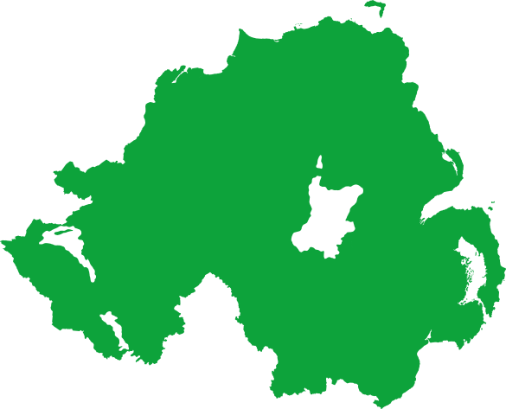
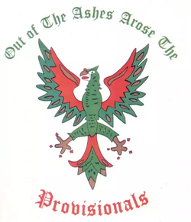
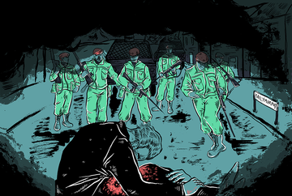
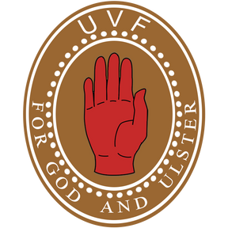

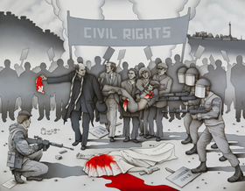
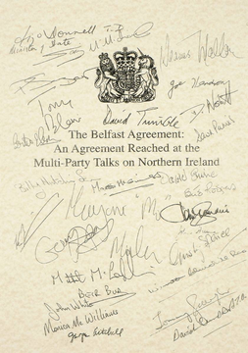


Chapter 30
THE TROUBLES
The Troubles in Northern Ireland begin, lasting for almost two decades.
The UVF set off bombs in Dublin and Monaghan in retribution for IRA attacks.
The Provisional IRA announce the end of their armed campaign
1966
1969
1972
1974
1998
2005
2007
Strand Two: The Nature of History
Chapter Thirty: Northern Ireland and The Troubles
The Ulster Volunteer Force (UVF) was founded
Bloody Sunday: British soldiers shot 26 unarmed civilians during a protest march in the Bogside.
The Good Friday Agreement is signed in Belfast
The UVF announce the end of their armed campaign
@MsDoorley

Slide 3
Learning Outcomes
2.5 IDENTIFY the causes, course and consequences of the Northern Ireland Troubles and their impact on North–South and Anglo-Irish relations.
1.2 CONSIDER contentious or controversial issues in history from more than one perspective and DISCUSS the historical roots of a contentious or controversial issue or theme in the contemporary world
1.7 DEVELOP historical judgements based on evidence about personalities, issues and events in the past, showing awareness of historical significance
Strand One: The Nature of History
Chapter Thirty: Northern Ireland and The Troubles
@MsDoorley

Slide 4
Introduction
Since its creation in 1921, Northern Ireland had been a divided society. Sectarian divisions between the Protestant majority and the Catholic minority meant the new state discriminated against Catholics. The resulting injustices led to protests and eventually to the outbreak of violence by paramilitary groups. Over 3,500 people lost their lives during the Troubles.
Strand One: The Nature of History
Chapter Thirty: Northern Ireland and The Troubles
@MsDoorley

Slide 5
1920-2007
Chapter 30
30.1: NORTHERN IRELAND, 1920-1963
30.1: northern ireland, 1920-1963
Strand Two: The History of Ireland
@MsDoorley

Slide 6
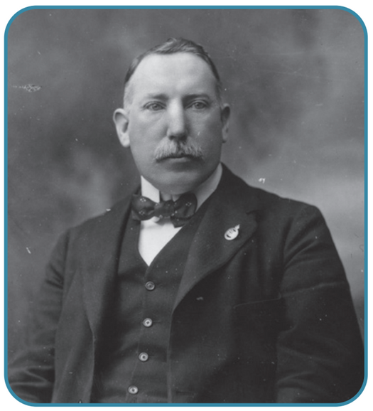
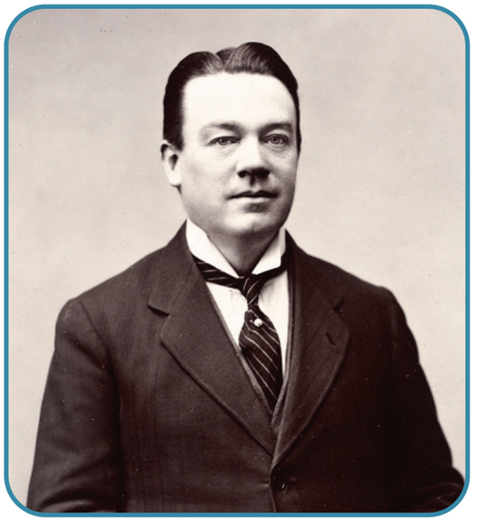
The establishment of Northern Ireland
While nationalists in the south of Ireland were trying to achieve independence, norther unionists wanted to remain in the United Kingdom.
The new state of Northern Ireland was set up under the Government of Ireland Act 1920, with the six counties of Armagh, Antrim, Down, Derry, Tyrone and Fermanagh. It had a form of Home Rule with its own parliament, later based at Stormont, Belfast. It was in control of internal affairs such as education and health care. This separation of the north and south of Ireland into two different states was called partition.
James Craig became Northern Ireland's first prime minister in 1920. The unionists refused to join the Irish Free State in 1921. Northern Ireland sent 12 MPs to Westminster from 1920, while its Northern Ireland parliament was dominated by the Unionist Party. Nationalists in Northern Ireland, led by Joseph Devlin, would not take their seats for six years in protests against the new state. This left the Unionist Party without any opposition.
Strand One: The Nature of History
Chapter Thirty: Northern Ireland and The Troubles
Diagram taken from Artefact, 2nd Edition by Eimear Jenkinson and Gregg O'Neill (educate.ie)
@MsDoorley

Slide 7
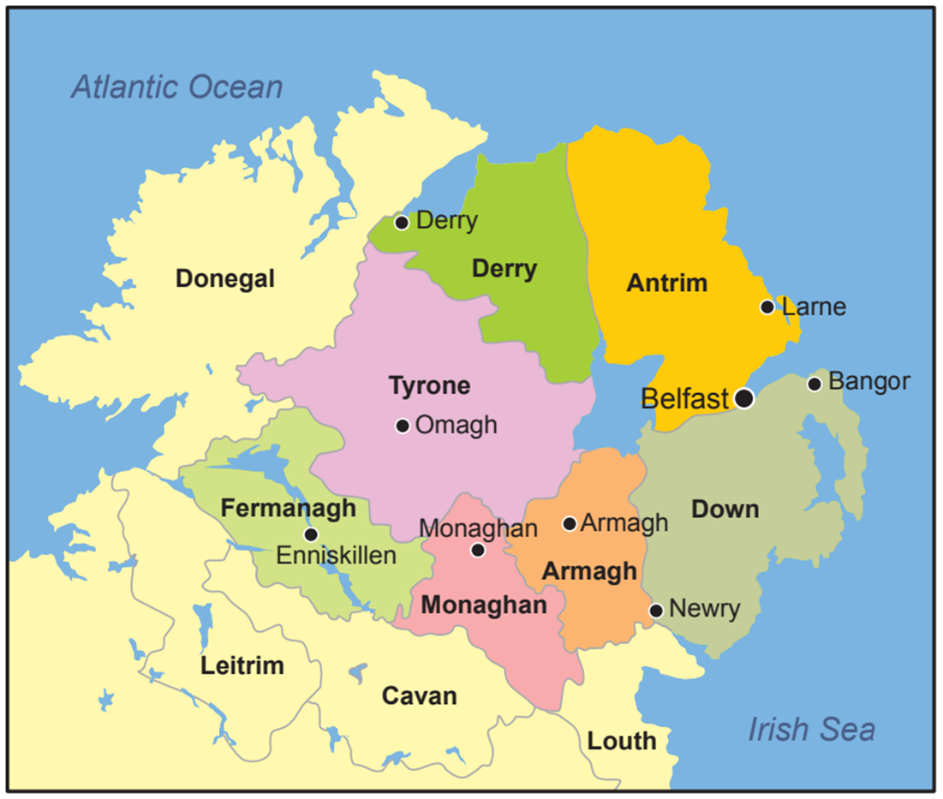
Strand One: The Nature of History
Chapter Thirty: Northern Ireland and The Troubles
Diagram taken from Artefact, 2nd Edition by Eimear Jenkinson and Gregg O'Neill (educate.ie)
@MsDoorley

Slide 8
The Sectarian State
The new Northern Irish state was a sectarian one that actively discriminated against the Catholics.
  Gerrymandering: When local elections were held in Northern Ireland, each part of a city was divide into wards. The Unionist Party made sure that the boundaries for the divisions were drawn up specifically to give unionist candidates the advantage over nationalist candidates. This rearrangement of voting districts to benefit one political party is known as gerrymandering. For example, Derry had a large Catholic population, but the Unionist Party still held the majority of council seats. Gerrymandering meant that throughout Northern Ireland, most councillors in the wards were unionists. This resulted in discrimination against nationalists in regard to housing, jobs, schools, local facilities and more.
  Multiple votes: In addition, owners of property and businesses received additional votes (and were mostly Protestants)
  Policing: The Royal Ulster Constabulary (RUC) were an exclusively Protestant armed police force. It had part-time special constabulary units such as the B-Specials who became known for their violence against Catholics.
  Housing: Catholics were passed over in favour of Protestants when Public Housing was being allocated.
  Education: Catholic schools received less funding from the government.
Strand One: The Nature of History
Chapter Thirty: Northern Ireland and The Troubles
@MsDoorley

Slide 9
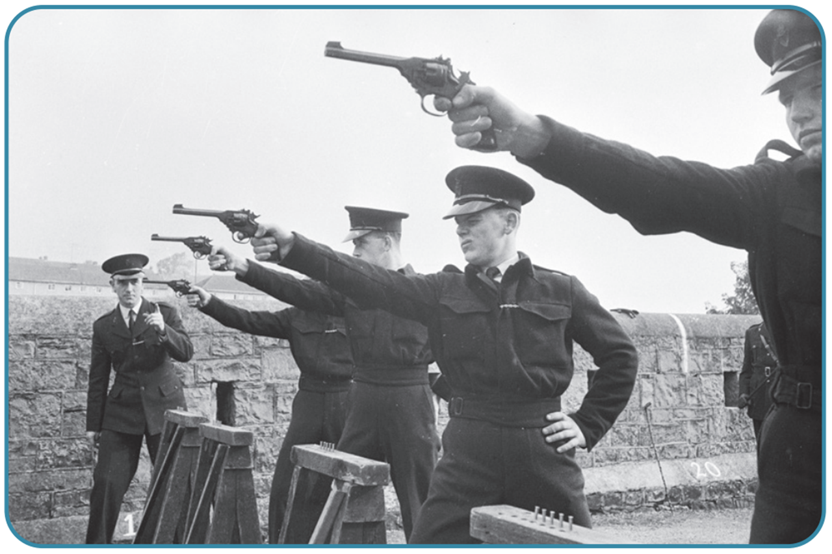
Strand One: The Nature of History
Chapter Thirty: Northern Ireland and The Troubles
Diagram taken from Artefact, 2nd Edition by Eimear Jenkinson and Gregg O'Neill (educate.ie)
@MsDoorley

Slide 10
World War II and the Welfare State
As part of the UK, Northern Ireland was fully involved in World War II. Belfast was heavily bombed during the Belfast Blitz but overall the North’s economy benefited from the war.
After the war, the British Labour Government under Clement Attlee included Northern Ireland in its new welfare state. This was a new programme of social spending by the government that made education and health care free to everyone, built more public housing and increased social welfare payments.
One of the most important effects of the welfare state on Northern Ireland was that it greatly expanded the funding available to Catholic schools. Many children who would otherwise have left school at 12 now went on to complete their secondary education and go to university. This first well-educated generation of Northern Irish Catholics would emerge in the 1960s to challenge discrimination their community faced.
Strand One: The Nature of History
Chapter Thirty: Northern Ireland and The Troubles
@MsDoorley

Slide 11
Checkpoint pg. 270 (Artefact, 2nd Edition)
  What did the Government of Ireland Act 1920 do to Ireland?
  What was the population make-up of Northern Ireland?
  How did the Unionists use the police to help them retain control?
  How were Catholics discriminated against in (a) education; (b) housing and (c) employment?
  Name one important impact on Northern Ireland of (a) World War II and (b) the welfare state.
  Why do you think that unionists took all these measures to prevent Catholics from gaining political power?
Strand Two: The Nature of History
Chapter Thirty: Northern Ireland and The Troubles
@MsDoorley

Slide 12
1920-2007
Chapter 30
30.2: THE O’NEILL YEARS, 1963-1969
30.2: the o’neill years, 1963-1969
Strand Two: The History of Ireland
@MsDoorley

Slide 13
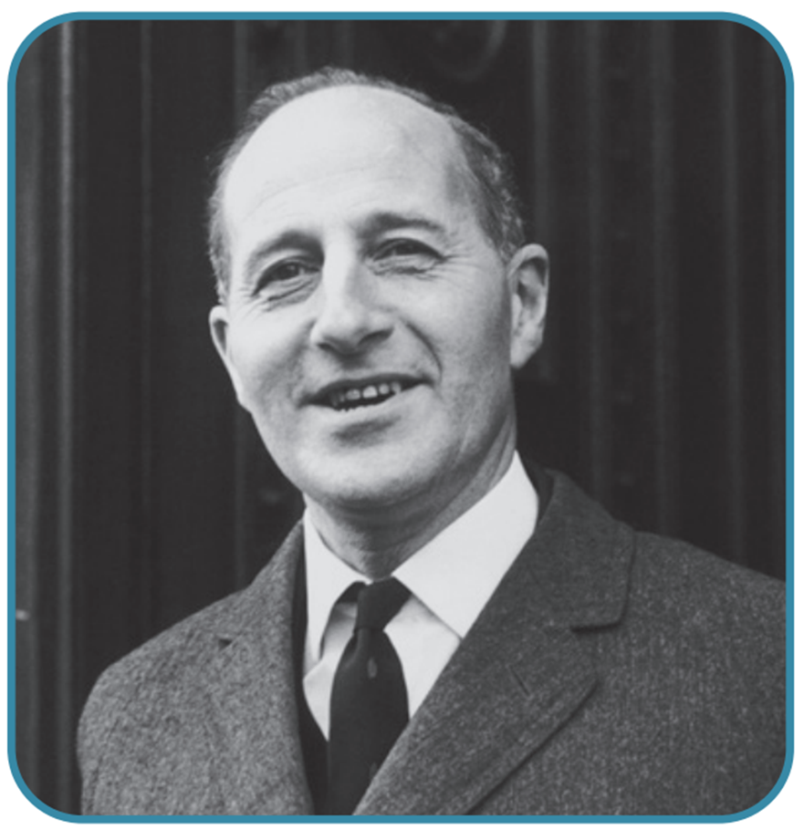
A fresh beginning?
In 1963, Terence O’Neill became Prime Minister of Northern Ireland. He was a young man, part of a new generation of politicians. Unlike his predecessors, he set out to “build bridges between our two communities”. His leadership was an opportunity to create a fairer Northern Ireland for everyone.
Strand One: The Nature of History
Chapter Thirty: Northern Ireland and The Troubles
Diagram taken from Artefact, 2nd Edition by Eimear Jenkinson and Gregg O'Neill (educate.ie)
@MsDoorley

Slide 14
O’Neill’s Economic Policies
The North’s economy had slowed in the 1950s as ship building and linen industries declined after WWII. O’Neill used tax breaks and grants to attract new industries and foreign businesses to the province. He was successful, creating 65,000 jobs by 1970. However these were predominately in the Protestant east while the Catholic west remained underdeveloped and poor.
Strand One: The Nature of History
Chapter Thirty: Northern Ireland and The Troubles
@MsDoorley

Slide 15
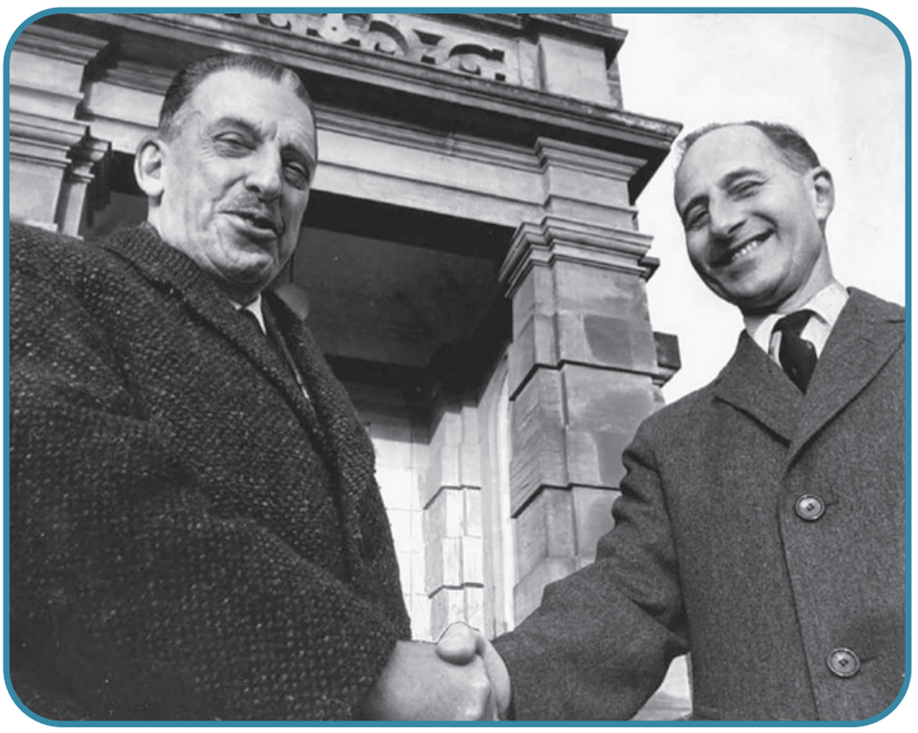
O'Neill's outreach to Catholics
O’Neill tried to improve relations with the Catholics. He was the first N.I Prime Minister to visit Catholic schools and hospitals. When the Pope died in 1963, he ordered flags to be flown at half-mast. In 1965, he met with the Republic’s Taoiseach, Seán Lemass. The first time this had been done on the island since 1920. Catholics began to hope for widespread changes but O’Neill was slow to make similar changes in housing or employment policies.
Strand One: The Nature of History
Chapter Thirty: Northern Ireland and The Troubles
Diagram taken from Artefact, 2nd Edition by Eimear Jenkinson and Gregg O'Neill (educate.ie)
@MsDoorley

Slide 16
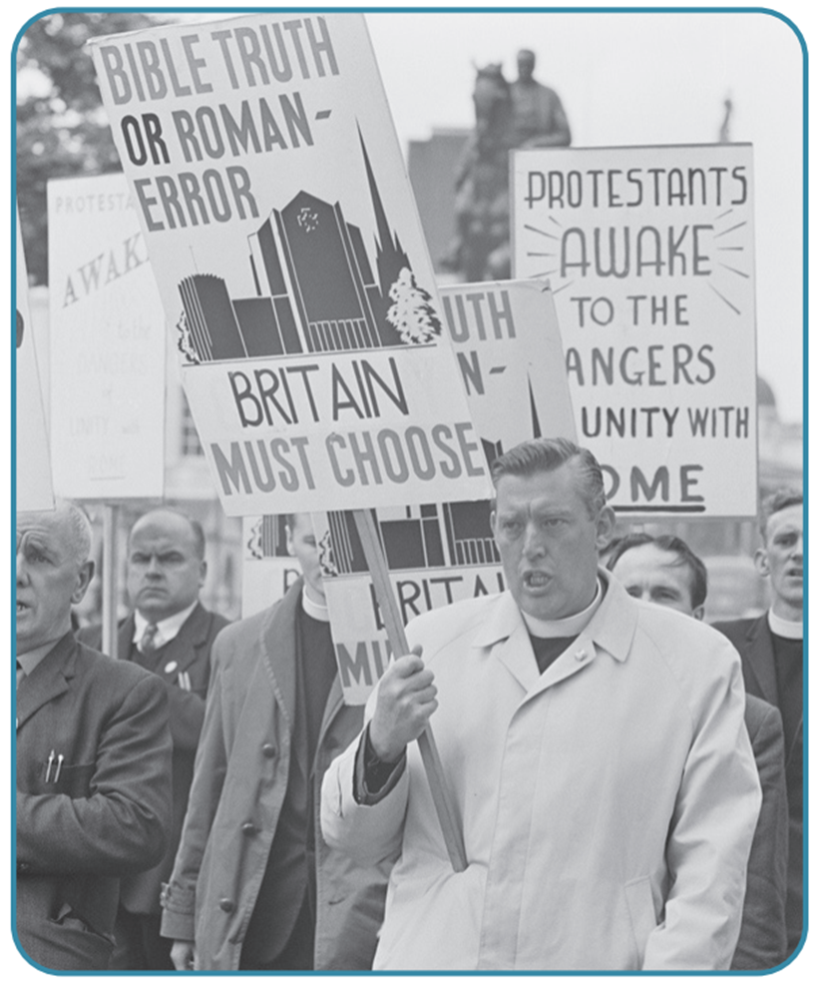
Unionist opposition to O’Neill
By 1965, Unionist opposition to O’Neill’s policies was growing despite no real change to Northern Irish society. Some of his own party (such as Brian Faulkner) were wary of his attempts to reconcile with the Catholics and the Republic, believing these things would undermine the position of unionists. Reverend Ian Paisley of the Free Presbyterian Church attacked O’Neill for betraying the Union and the Protestants. Paisley launched an “O’Neill Must Go” campaign. This opposition made it difficult for O'Neill to respond positively to growing pressure from Catholics for change.
Strand One: The Nature of History
Chapter Thirty: Northern Ireland and The Troubles
Diagram taken from Artefact, 2nd Edition by Eimear Jenkinson and Gregg O'Neill (educate.ie)
@MsDoorley

Slide 17
Checkpoint pg. 271 (Artefact, 2nd Edition)
  What were Terence O’Neill’s economic policies?
  How did they worsen the divisions in Northern Ireland?
  What steps did O’Neill take to reach out to Catholics?
  What impact did these have on Catholics?
  Why did Unionist opposition to O’Neill emerge?
Strand Two: The Nature of History
Chapter Thirty: Northern Ireland and The Troubles
@MsDoorley

Slide 18
The Civil Rights Movement
Catholics became increasingly frustrated with the lack of progress in Northern Ireland and decided to campaign more actively for a change in their status. In the late 1960s, a new generation of Catholic and nationalist leaders emerged. These included: Gerry Fitt, John Hume, Austin Currie and Bernadette Devlin. They formed the Northern Ireland Civil Rights Association (NICRA) in 1967. Its demands were:
  A disbandment of the B-Specials
  An end to discrimination in housing and employment
  “one man, one voice” in voting
  An end to gerrymandering.
NICRA were not concerned with the question of partition or a united Ireland; they simply wanted British Rights for British Citizens. However, many unionists, pointing at the nationalist politicians involved in NICRA, dismissed it as a 'republican plot' against Northern Ireland and therefore refused all of their demands.
NICRA was committed to peaceful means to achieve change. It modelled on the Civil Rights Movement of African-Americans led by Dr Martin Luther King Jr in the USA. NICRA organised marches, petitions, legal aid, boycotts. The RUC and government banned marches, claiming risk of violence between NICRA and extra unionist counter-marches led by Ian Paisley.
In October 1968, a banned NICRA march in Derry went ahead. It was attacked by the RUC and images of this were captured by TV cameras. That night in Derry, there was mass rioting and violent clashes between Catholic youths and the RUC.
Strand One: The Nature of History
Chapter Thirty: Northern Ireland and The Troubles
@MsDoorley

Slide 19
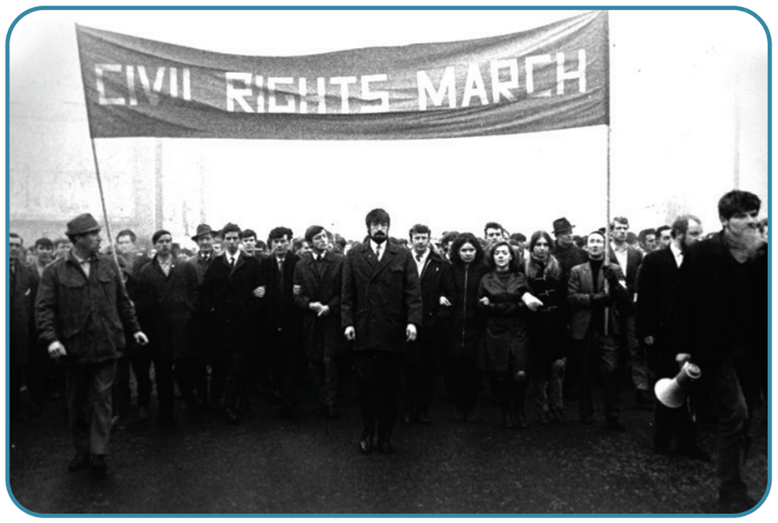
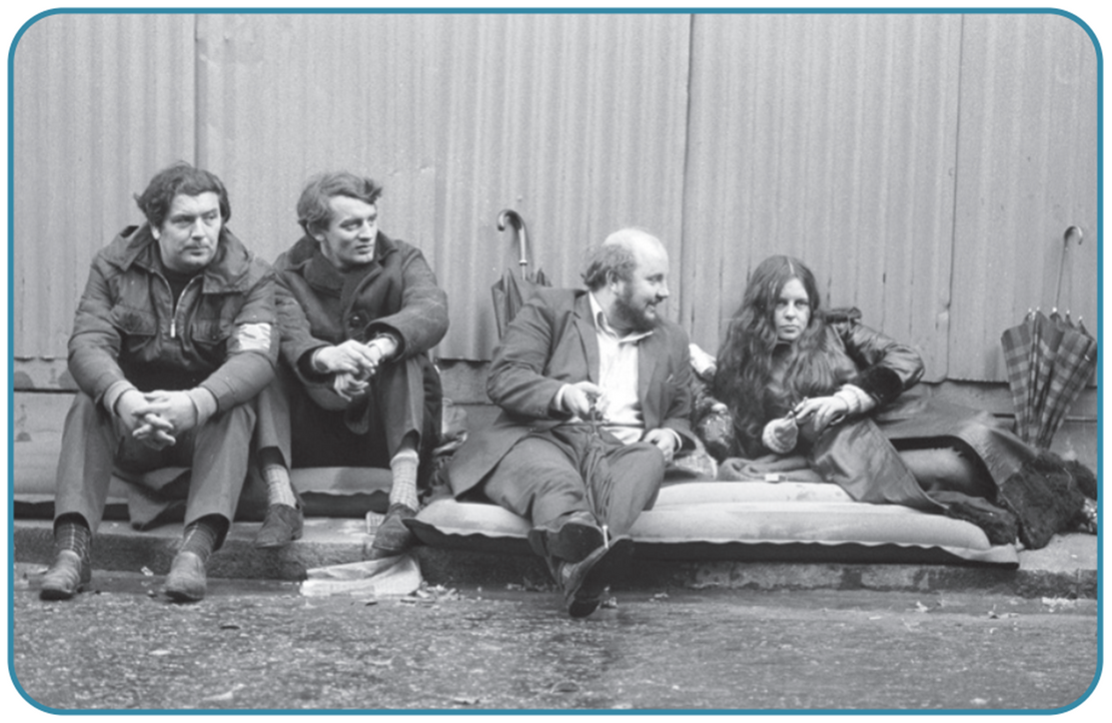
Strand One: The Nature of History
Chapter Thirty: Northern Ireland and The Troubles
Diagram taken from Artefact, 2nd Edition by Eimear Jenkinson and Gregg O'Neill (educate.ie)
@MsDoorley

Slide 20
Checkpoint pg. 272 (Artefact, 2nd Edition)
  Why was the NICRA set up?
  What were its aims?
  What were its methods? Why did its members choose these methods?
  How did Unionists respond to it?
  How did violence break out in 1968?
  Do you think O’Neill was a success or a failure as Prime Minister of Northern Ireland? Give four reasons for your answer.
Strand Two: The Nature of History
Chapter Thirty: Northern Ireland and The Troubles
@MsDoorley

Slide 21
1920-2007
Chapter 30
30.3: THE BEGINNING OF THE TROUBLES
30.3: the beginning of the troubles
Strand Two: The History of Ireland
@MsDoorley

Slide 22
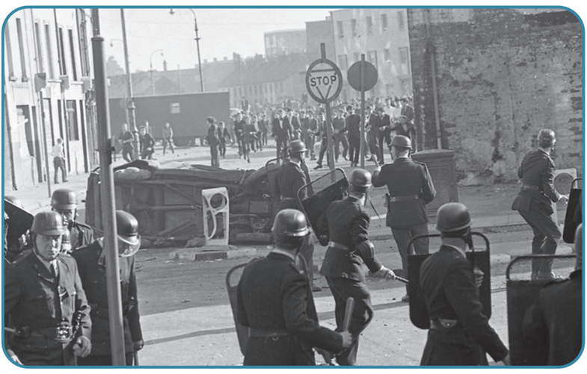
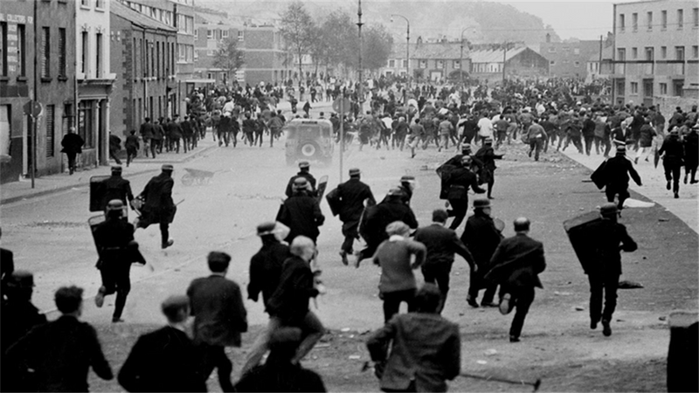
The Battle of the Bogside
Violence continued on the streets through 1969. In August, there were riots when the Unionist Apprentice Boys passed through the Catholic Bogside area of Derry. The rioters drove the RUC out of the Bogside using stones and home-made firebombs (nicknamed Molotov cocktails). They raised barricades and declared the area 'Free Derry'. This became known as the Battle of the Bogside, with violence spreading to Belfast as Unionist rioters attacked Catholic homes. The British army was ordered into thee streets, initially welcomed by the Catholics their approval would soon change.
Strand One: The Nature of History
Chapter Thirty: Northern Ireland and The Troubles
@MsDoorley

Slide 23
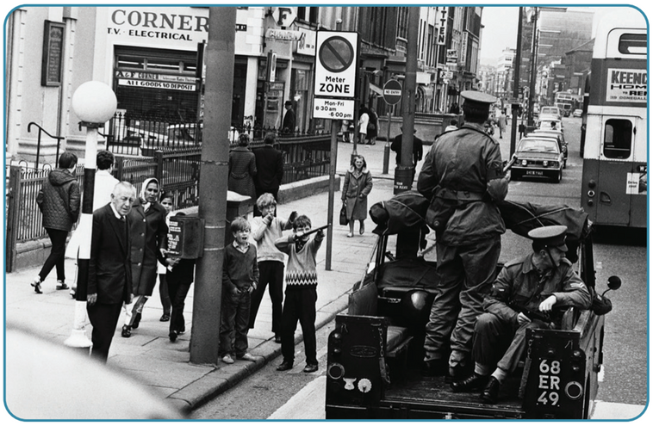
The Violence Escalates
There were soon clashes between rioters on both sides and with the soldiers. In the midst of the violence, new terrorist (or paramilitary) groups sprang up. Terrorism is the use of fear and acts of violence to try to change society or government policy for a political or ideological purpose. In Northern Ireland, terrorists targeted both the security forces and innocent civilians.
  The Provisional IRA (The Provos - not to be confused with the IRA during the struggle for Irish Independence 1919-1923): Splitting from the Dublin-Based IRA in 1969, they carried out attacks on the RUC and the army, planted bombs in Britain and Northern Ireland and killed innocent civilians whom they claimed were working for the British. Sinn Féin is considered their political wing; led by Gerry Adams from the mid-1980s.
  Loyalists: On the other side, the Ulster Volunteer Force (UVF) and the Ulster Defence Association (UDA) were set up. Loyalists are Unionist who were willing to use (or support the use of) paramilitary violence to defend the Union. They attacked Catholic as reprisals for IRA attacks.
Strand One: The Nature of History
Chapter Thirty: Northern Ireland and The Troubles
Diagram taken from Artefact, 2nd Edition by Eimear Jenkinson and Gregg O'Neill (educate.ie)
@MsDoorley

Slide 24
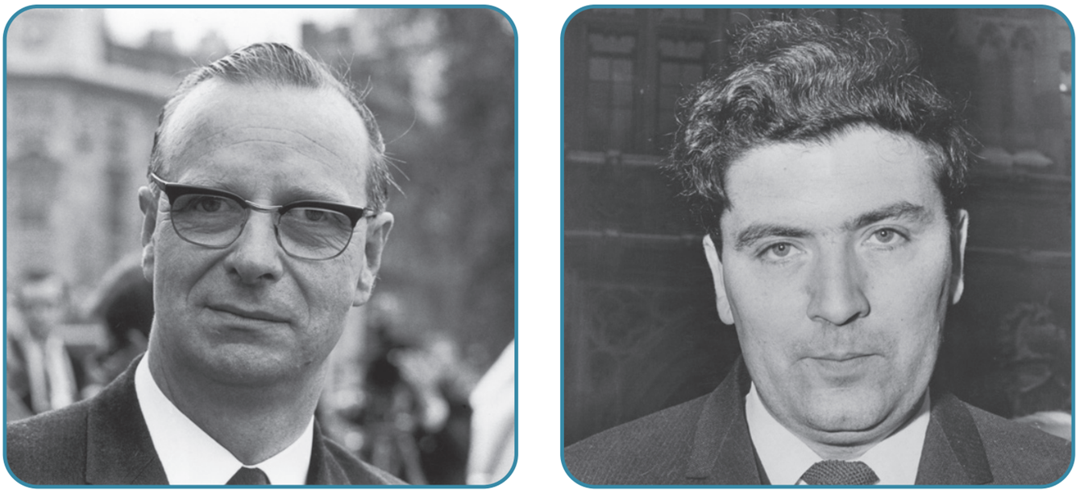
New Political Parties
The Social Democratic and Labour Party (SDLP) was founded as a new nationalist political party in 1970. It was first led by Gerry Fitt before John Hume took over. It rejected the use of violence to solve the problems of the North and was more concerned with the issues of the people than a united Ireland.
The Democratic Unionist Party (DUP) was founded by Rev. Ian Paisley in 1971. It opposed any compromise with nationalists and demanded harsh measures to deal with IRA violence.
Strand One: The Nature of History
Chapter Thirty: Northern Ireland and The Troubles
Diagram taken from Artefact, 2nd Edition by Eimear Jenkinson and Gregg O'Neill (educate.ie)
@MsDoorley

Slide 25
Internment
In 1970 and 1971, the IRA carried out gun attacks on the security forces. They also organised youths in Catholic areas to throw stones and riot. In response, the army held house searches in these areas, quickly losing the support of the Catholic population.
In August 1971, as the violence worsened, the new Prime Minister of Northern Ireland Brian Faulkner introduced the policy of Internment. Internment is the arrest and imprisonment of people without trial. Instead of rounding up the IRA leadership, the tactic was a complete disaster.
  A lot of innocent people were arrested and held while most of the IRA leaders had escaped to the Republic.
  Only Catholics were arrested despite many loyalist attacks on the Catholic communities for two years. The bias of the British and Unionists led to more people joining the IRA as a result of the internment policy.
Strand One: The Nature of History
Chapter Thirty: Northern Ireland and The Troubles
@MsDoorley

Slide 26
Bloody Sunday
The Fourth Bloody Sunday in 20th Century Irish History; Dublin 1913, Dublin 1920, Belfast 1921 and Derry 1972.
On the 30th January 1972, NICRA organised a march to protest against internment in Derry. It was banned but 15,000 marched anyways. The British army was sent into the Bogside following reports of an IRA sniper. When Catholics youths threw stones at an army barricade, soldiers opened fire on the crowd, killing 14 unarmed protesters and injuring 13 more. The soldiers claimed they were fired upon but no one else heard shots nor were their any rifles found. The actions of the British soldiers on Bloody Sunday drew protests around the world. In Dublin, protesters burned down the British Embassy. Eventually a British government investigation in 2010 cleared the civilians of any responsibility for the deaths that day.
Strand One: The Nature of History
Chapter Thirty: Northern Ireland and The Troubles
@MsDoorley

Slide 27
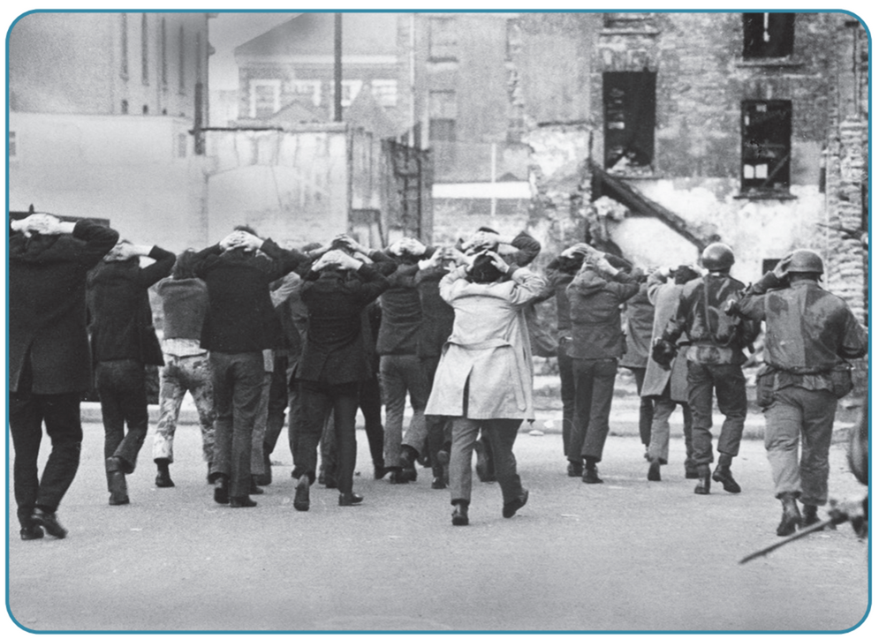
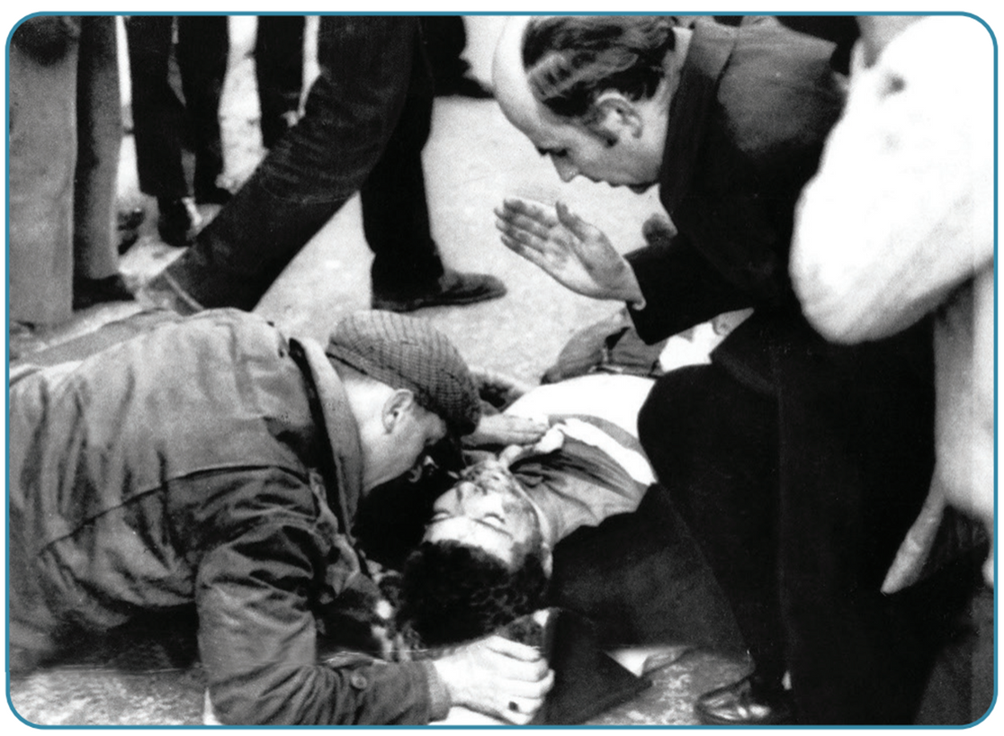
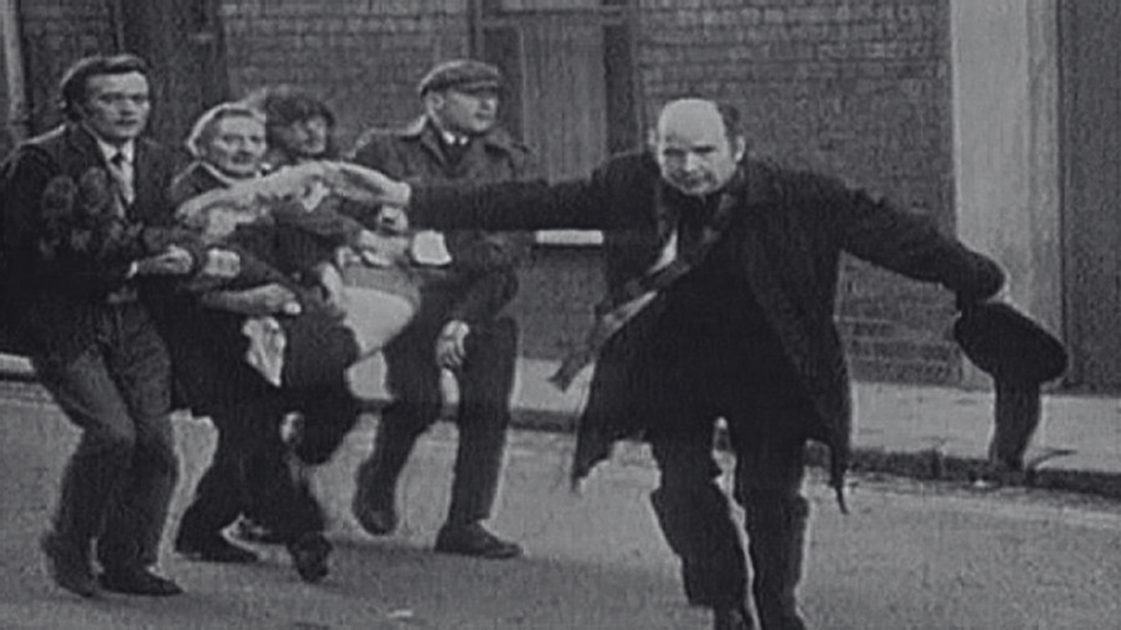
Strand One: The Nature of History
Chapter Thirty: Northern Ireland and The Troubles
Diagram taken from Artefact, 2nd Edition by Eimear Jenkinson and Gregg O'Neill (educate.ie)
@MsDoorley

Slide 28





Contentious Issue
The events of Bloody Sunday were among the most controversial of the Troubles. The British government immediately established the Widgery Tribunal to investigate the events of that day. The tribunal interviewed only the soldiers involved and its reports declared that the soldiers were innocent of any wrongdoing, saying they had acted in self-defence, and blamed the organisers of the march for the deaths. This report was harshly criticised by the families of the victims and the wider nationalist community, but was welcomed by the unionist community. The victims' families launched a campaign for justice and demanded a new report. Along with the Irish government, they spent over 20 years researching and investigating the events of Bloody Sunday. In 1998, the British government of Prime Minister Tony Blair finally ordered a new report, the Saville Inquiry. This took 12 years of hearings with former soldiers, eyewitnesses, officials and experts, as well as extensive investigations. In 2010, its reports was eventually published and this rejected the Widgery Tribunal's findings. British Prime Minister David Cameron declared that the killings of the 14 people on Bloody Sunday were "unjustified and unjustifiable' and that "the immediate responsibility for the deaths and injuries on Bloody Sunday lies with those [soldiers] whose unjustifiable firing was the cause of those deaths and injuries".
Strand One: The Nature of History
Chapter Thirty: Northern Ireland and The Troubles
Diagram taken from Artefact, 2nd Edition by Eimear Jenkinson and Gregg O'Neill (educate.ie)
@MsDoorley

Slide 29
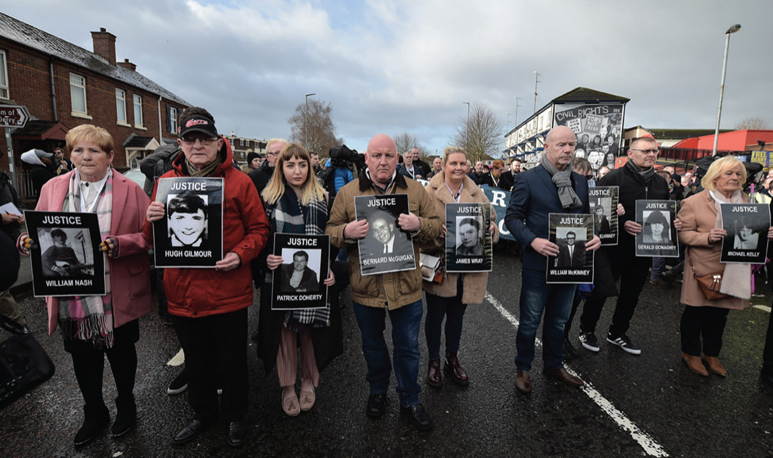
Strand One: The Nature of History
Chapter Thirty: Northern Ireland and The Troubles
Diagram taken from Artefact, 2nd Edition by Eimear Jenkinson and Gregg O'Neill (educate.ie)
@MsDoorley

Slide 30
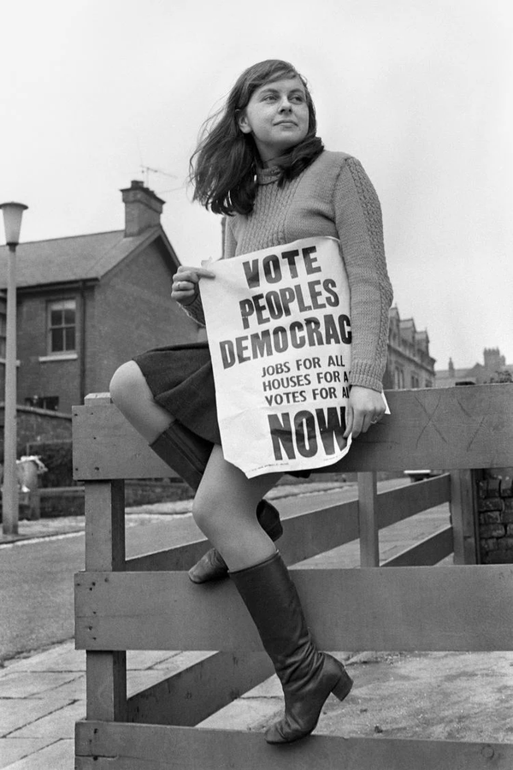
Bernadette Devlin, 1947-
Bernadette Devlin was born into a working-class Catholic family in Cookstown, Co. Tyrone. She availed of the free education brought in under the welfare state and wet to study Psychology at Queen's University Belfast. She became active in the radical civil rights group People's Democracy and led a number of civil rights marches in 1968 and 1969. She was expelled from university after being convicted of 'incitement to riot'. She supported other protest movements around the world and demonstrated that support for African American's civil rights on a 1969 visit to the USA. Aged 21, she was elected for Mid-Ulster to the British parliament in Westminster.
Devlin was present in Derry during the Battle of the Bogside and on Bloody Sunday in 1972. In the House of Commons the day after Bloody Sunday, Devlin slapped a British minister across the face when he claimed that the soldiers had simply been defending themselves. She lost her seat in 1974. She survived an assassination attempt by the UDA in 1981 and remained active in radical left-wing politics in Northern Ireland.
Strand Two: The History of Ireland
Chapter Thirty: Northern Ireland and The Troubles
@MsDoorley

Slide 31
Long-term causes | Short-term causes
Discrimination against Catholics in jobs, education and housing. | Failure of O'Neill's attempt at reform.
Gerrymandering | Reaction to the Civil Rights Movement
Sectarian policing | The Battle of the Bogside
Impact of the Welfare State.
Strand One: The Nature of History
Chapter Thirty: Northern Ireland and The Troubles
@MsDoorley

Slide 32
Checkpoint pg. 276 (Artefact, 2nd Edition)
  Describe the Battle of the Bogside.
  Why were British troops sent onto the streets on Northern Ireland in 1969?
  Explain the term terrorism.
  Explain who these groups are: the IRA; the UDA; the SDLP; the DUP.
  Explain the term internment.
  What happened on Bloody Sunday 1972?
  Why was Bloody Sunday such a controversial event?
Strand Two: The Nature of History
Chapter Thirty: Northern Ireland and The Troubles
@MsDoorley

Slide 33
Checkpoint pg. 276 (Artefact, 2nd Edition)
  In August 1969, there were riots when a march by the unionist Apprentice Boys passed through the Catholic Bogside area of Derry. The rioters drove the RUC out of the Bogside,throwing stones and home-made firebombs(Molotov cocktails). They raised barricades across the streetsand declared the area ‘Free Derry’.
  British troops were meant to end the violent clashesbetween the RUC and Catholicrioters.
  Terrorism: the use of fear and acts of violenceto try to change societyor government policy for a political or ideological purpose.
  IRA: a republican terrorist group (the Irish Republican Army); UDA: a loyalist terrorist group (the Ulster Defence Association); SDLP: a moderatenationalist party that rejected violence(the Social Democratic and Labour Party);DUP: a hardline unionist partyopposed to any compromise with nationalists (the Democratic UnionistParty).
  Internment: the arrest and imprisonment of people without trial.
  On Bloody Sunday (30 January1972), British troops shot 14 anti-internment protestors dead during a banned civilrights march in Derry.
  Firstly, 14 civilians were shot dead by the army; secondly the inquiry afterwards blamed the protesters for the deaths,saying the soldiersacted in self defence; this was rejectedby the families of the victims, who campaigned for justicefor the next 25 years.
Strand Two: The Nature of History
Chapter Thirty: Northern Ireland and The Troubles
@MsDoorley

Slide 34
1920-2007
Chapter 30
30.4: THE SUNNINGDALE AGREEMENT
30.4: the sunningdale agreement
Strand Two: The History of Ireland
@MsDoorley

Slide 35
Stormont suspended
In the aftermath of Bloody Sunday, the British government saw that the Unionist government was failing to deal with the crisis. It decided to introduce direct rule from London. The Stormont parliament was suspended in March 1972 by British Prime Minister Edward Heath. He appointed Willie Whitelaw as Secretary of State for Northern Ireland. Whitelaw wanted this to be a temporary measure and tried to restore local control as quickly as possible.
Strand One: The Nature of History
Chapter Thirty: Northern Ireland and The Troubles
@MsDoorley

Slide 36
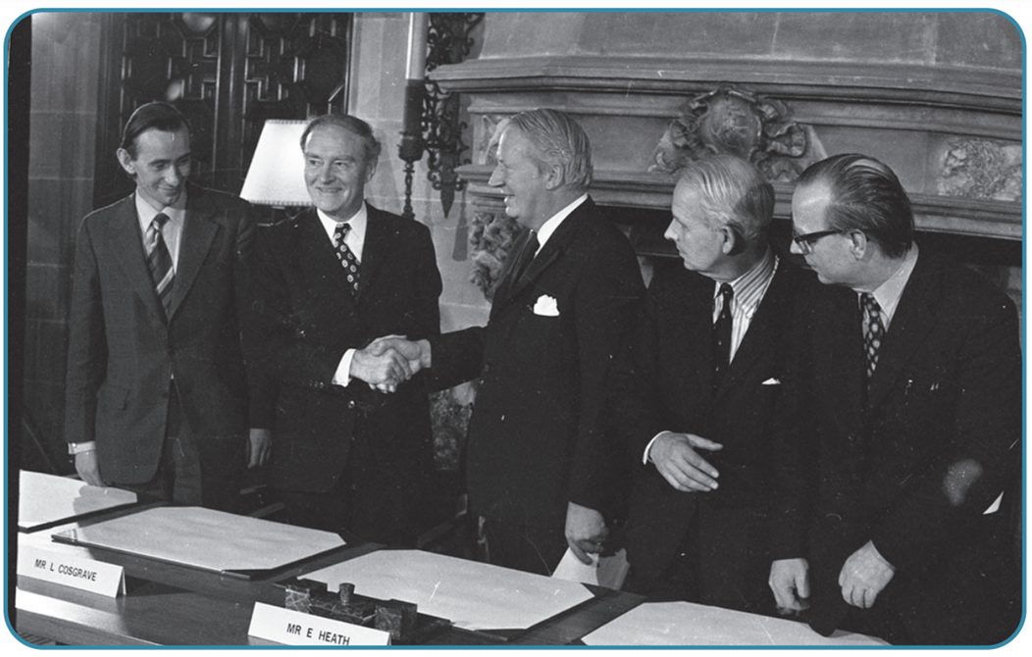
The signing of the Sunningdale Agreement
In 1973, elections took place for a new Northern Ireland Assembly. Afterwards, Whitelaw invited the part leaders to talks. He wanted to set up a power-sharing government where Unionists and Nationalists would govern together. Eventually, in December 1973, Unionist Party leader (Brian Faulkner), the SDLP leader (Gerry Fitt), the British Prime Minister (Edward Heath) and Irish Taoiseach (Liam Cosgrove) signed the Sunningdale Agreement. Its terms:
  A power-sharing executive would be established between the Unionist Party, the SDLP, and a small Unionist party, the Alliance.
  A Council of Ireland was to be set up consisting of politicians from the North and the Republic in an attempt to undermine IRA violence.
Strand One: The Nature of History
Chapter Thirty: Northern Ireland and The Troubles
Diagram taken from Artefact, 2nd Edition by Eimear Jenkinson and Gregg O'Neill (educate.ie)
@MsDoorley

Slide 37
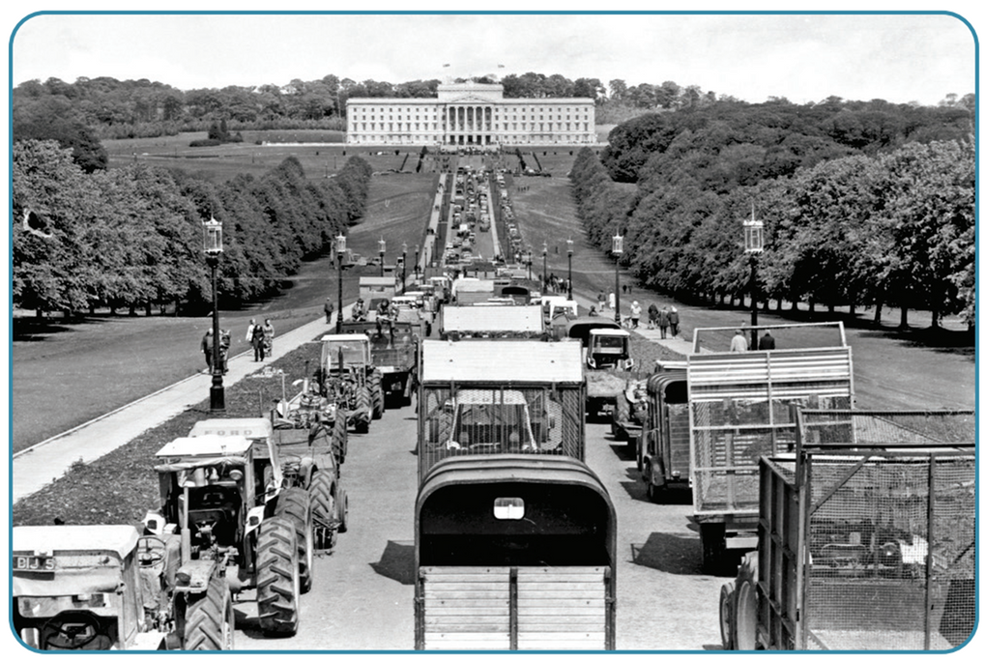
The Ulster Workers’ Council Strike
The executive took office in January 1974, faced with opposition from both sides.
  The IRA continued its campaign of violence, claiming the Agreement did not bring about a United Ireland while Unionists saw little point in a deal that didn’t end the violence.
  Unionist opposition was widespread. Members of Faulkner’s own party and the DUP opposed power sharing with Nationalists. They despised the Council of Ireland, claiming it would undermine the Union and lead to a united Ireland.
In •May 1974, the Unionist Ulster’s Workers’ Council organised a general strike. Goods would not be transported, factories were shut down, electricity was shut off. The executive resigned and the Sunningdale Agreement collapsed. Direct rule from London was re-imposed.
Strand One: The Nature of History
Chapter Thirty: Northern Ireland and The Troubles
Diagram taken from Artefact, 2nd Edition by Eimear Jenkinson and Gregg O'Neill (educate.ie)
@MsDoorley

Slide 38
Checkpoint pg. 278 (Artefact, 2nd Edition)
  Why did the British government suspend Stormont in 1972?
  Why did the British government think that power sharing would be a solution to the problems in Northern Ireland?
  What was agreed as part of the Sunningdale Agreement?
  Who were the leaders who signed the Agreement? Why do you think it was important that they did?
  Why did (a) the IRA and (b) some Unionists oppose the Agreement?
  How did the Ulster Workers’ Council bring about the end of the Agreement?
Strand Two: The Nature of History
Chapter Thirty: Northern Ireland and The Troubles
@MsDoorley

Slide 39
Checkpoint pg. 278 (Artefact, 2nd Edition)
1. Britain felt that the unionist government was failing to deal with the crisis situation.
2. The British hoped that if unionists and nationalists could work together in government, many of the causes of the violence could be resolved.
3. There would be a power-sharing executive between the Unionist Party, the SDLP and the Alliance Party, and a cross-border Council of Ireland to promote cooperation between north and south.
4. The leaders of the Unionist Party (Brian Faulkner), the SDLP (Gerry Fitt), the British government (Edward Heath) and the Irish government (Liam Cosgrave) signed the Sunningdale Agreement. Support was needed from all sides to solve the problems in Northern Ireland.
5. (a) The IRA opposed the Sunningdale Agreement as it did not end partition; (b) Some Unionists did not want power-sharing or the Council of Ireland.
6. The Ulster Workers’ Council organised a massive strike that shut down Northern Ireland; goods could not be transported, electricity was cut off and businesses/factories shut down.
Strand Two: The Nature of History
Chapter Thirty: Northern Ireland and The Troubles
@MsDoorley

Slide 40
1920-2007
Chapter 30
30.5: STALEMATE
30.5: stalemate
Strand Two: The History of Ireland
@MsDoorley

Slide 41
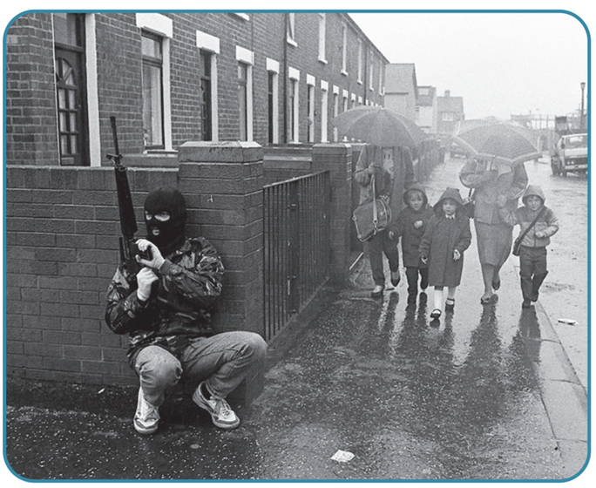
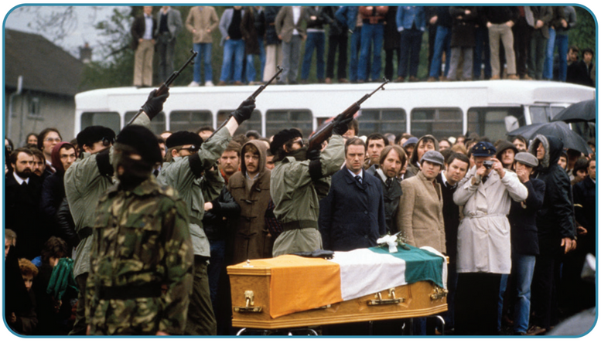
Violence by Terrorist Groups - IRA
While a political solution was being pursued, violence was a near-constant existence on the streets of Northern Ireland. The IRA adopted a tactic they called “spectaculars” – staging large-scale attacks on the British mainland to make Britain want to exit Northern Ireland. For example, the Birmingham Pub Bombings of November 1974 killed 21 people and injured 182 people. Attacks like this led to a lot of anti-Irish feeling in Britain.
In addition to the attacks in Britain (primarily England), the IRA also carried out attacks in Northern Ireland. They claimed to be targeted at the RUC and the army but these attacks claimed the lives of many innocent civilians. The IRA was responsible for the deaths of over 3,500 people during the Troubles.
Strand One: The Nature of History
Chapter Thirty: Northern Ireland and The Troubles
Diagram taken from Artefact, 2nd Edition by Eimear Jenkinson and Gregg O'Neill (educate.ie)
@MsDoorley

Slide 42
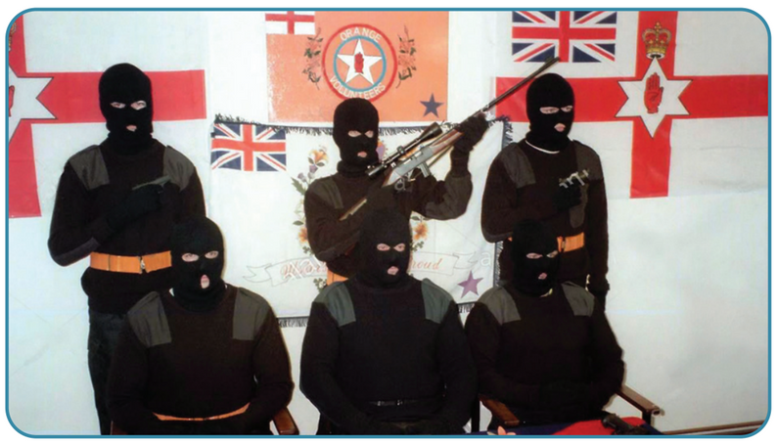
Violence by Terrorist Groups - Loyalists
Loyalists terrorist groups also engaged in brutal attacks on civilians. The most prolific of these was the Unionist Volunteer Force. They did not have the IRA's funding, bomb-making skills or resources. Most of the attacks by the Loyalist groups focused on killing Catholic civilians in Northern Ireland in supposed retaliation for IRA actions. These attacks were intended to terrify the Catholic population but led to a rise in anti-Protestant feelings in Catholic areas. The Dublin and Monaghan Bombings of May 1974 killed 33 civilians and injured 300 when a series of car bombs went off during rush hour. The UVF later claimed responsibility for the bombings.
The security forces in Northern Ireland also killed many civilians while attempting to find and stop terrorist on both sides. Unfortunately, due to these forces being mostly a) British and b) Protestant, Catholic civilians were the higher casualty rate of the RUC and army.
Strand One: The Nature of History
Chapter Thirty: Northern Ireland and The Troubles
Diagram taken from Artefact, 2nd Edition by Eimear Jenkinson and Gregg O'Neill (educate.ie)
@MsDoorley

Slide 43
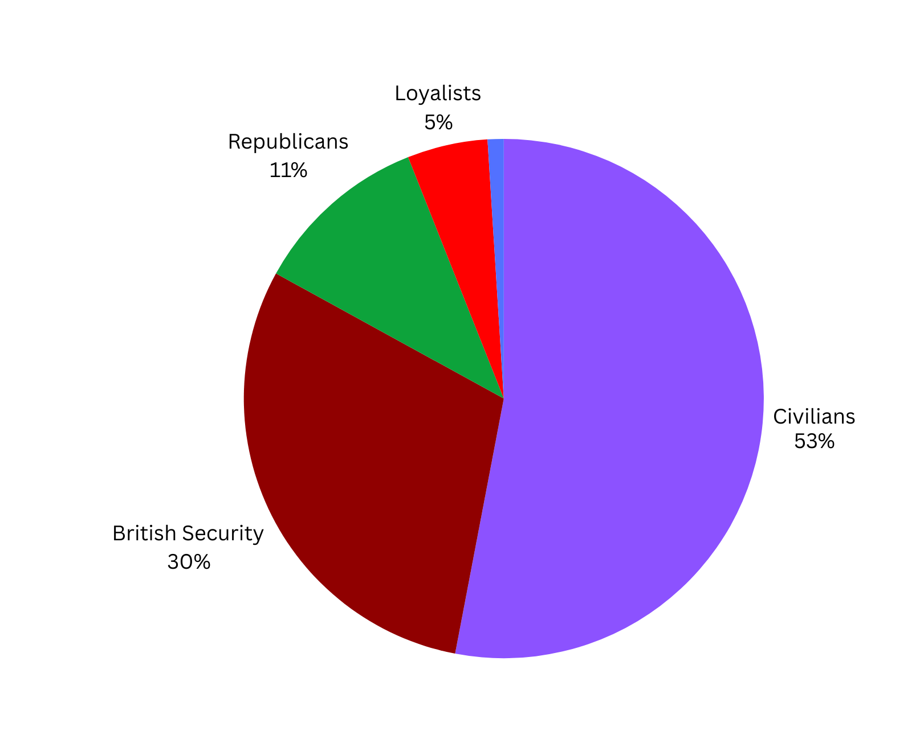
Strand One: The Nature of History
Chapter Thirty: Northern Ireland and The Troubles
Diagram taken from Artefact, 2nd Edition by Eimear Jenkinson and Gregg O'Neill (educate.ie)
@MsDoorley

Slide 44
The Hunger Strikes
While violence raged and the politic talks were stalled, a new strategy was attempted. In the late 1970s, IRA prisoners in the Maze Prison outside Belfast demanded ‘political status’ (to be treated as political prisoners rather than as ordinary criminals). Margaret Thatcher’s government rejected these demands. In 1981, prisoners led by Bobby Sands went on a hunger strike, which meant they refused all food until their demands were met.
The hunger strike generated sympathy around the world, especially in the Republic. Anti-British feelings rose across the world, not just in Ireland but in key European countries and the USA. Tensions arose between the Irish and British governments as the Irish urged Thatcher to concede to some demands. During the Strike, Bobby Sands was elected a Westminster MP. However, when Thatcher refused to back down and Sands died after 66 days on hunger strike. Nine more prisoners died before the IRA called off the strike.
The Strike gathered international attention to the Troubles. Sands’ election showed that the IRA could pursue a political strategy as well as a military one. Its political wing, Sinn Féin, began to take part in electoral politics and tried to win support on the basis of its polities and arguments.
Strand One: The Nature of History
Chapter Thirty: Northern Ireland and The Troubles
@MsDoorley

Slide 45
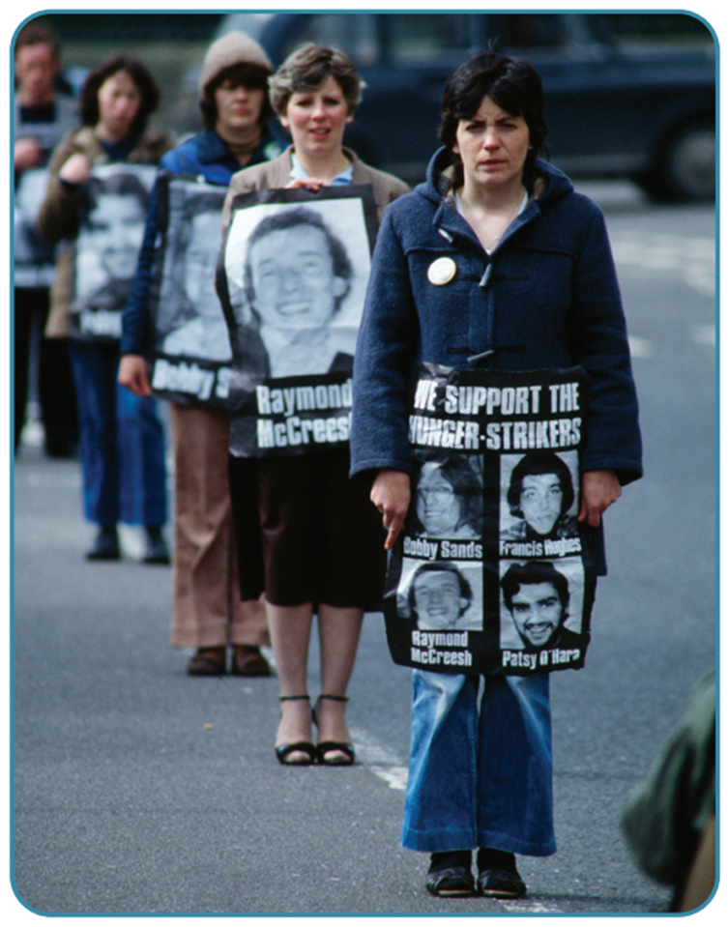
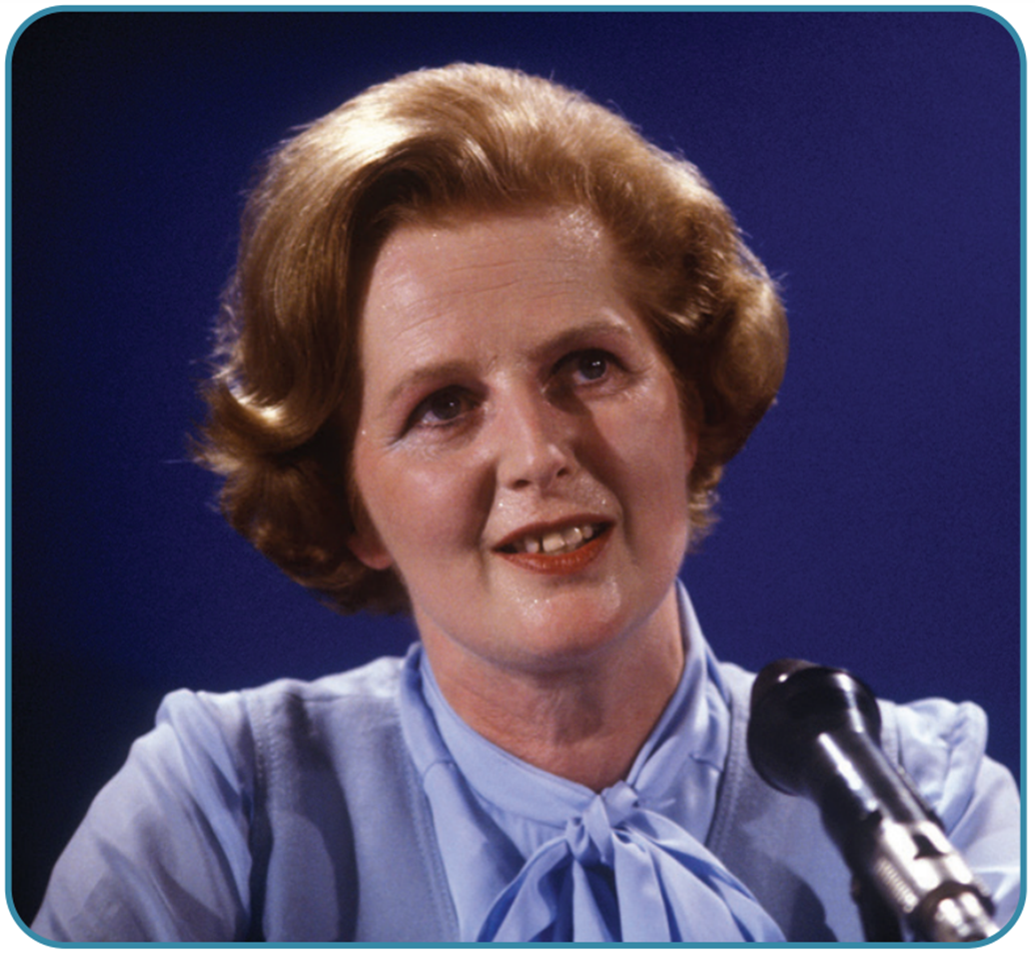
Strand One: The Nature of History
Chapter Thirty: Northern Ireland and The Troubles
Diagram taken from Artefact, 2nd Edition by Eimear Jenkinson and Gregg O'Neill (educate.ie)
@MsDoorley

Slide 46
Checkpoint pg. 280 (Artefact, 2nd Edition)
  What tactics were employed by the IRA during the Troubles?
  What tactics were employed by the loyalists?
  Why did IRA prisoners go on hunger strike in 1981?
  What was the British reaction to the hunger strikes? Why do you think this was?
Strand Two: The Nature of History
Chapter Thirty: Northern Ireland and The Troubles
@MsDoorley

Slide 47
Checkpoint pg. 280 (Artefact, 2nd Edition)
1. The IRA used ‘spectaculars’ (large-scale attacks on the British mainland) as well as frequent attacks in Northern Ireland targeting the RUC and the British army. They also used Hunger Strikes in prison to demand political status rather than be kept as ordinary criminals.
2. Loyalists engaged in brutal attacks on civilians, often killing innocent Catholics.
3. IRA prisoners demanded political status, which meant they would be treated as political prisoners rather than as ordinary criminals – to wear their own clothes and have more visits and contact with the outside.
4. The British government refused to compromise, believing that if they conceded it would be seen as a victory for the IRA and for its violent tactics.
Strand Two: The Nature of History
Chapter Thirty: Northern Ireland and The Troubles
@MsDoorley

Slide 48
1920-2007
Chapter 30
30.6: THE SEARCH FOR PEACE, 1985-1998
30.6: the search for peace, 1985-1998
Strand Two: The History of Ireland
@MsDoorley

Slide 49
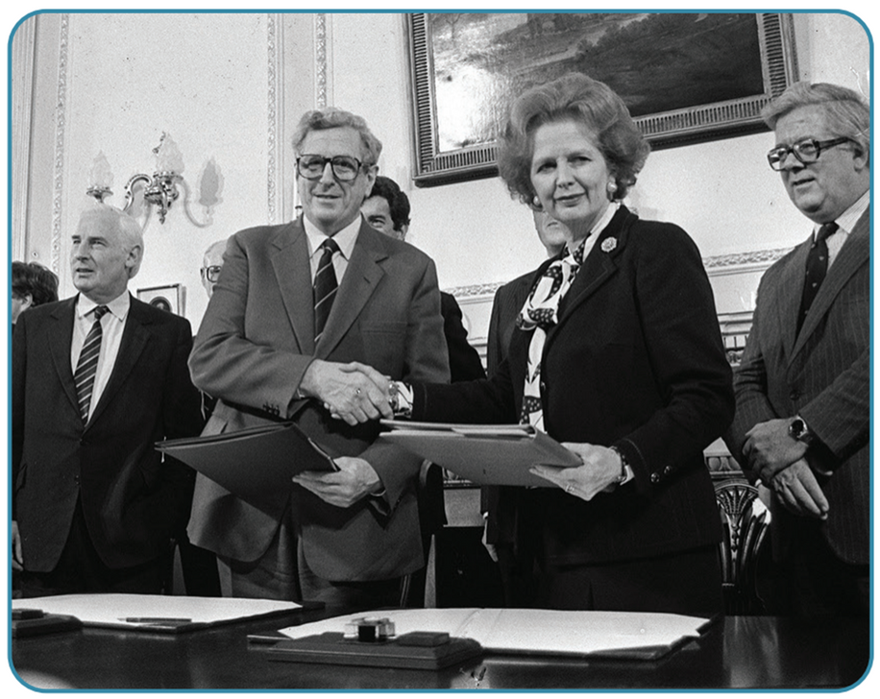
The Anglo-Irish Agreement 1985
By 1985, the Irish and British governments were looking for a new way to work together and finally bring peace to the island of Ireland. As the violence continued to terrorise the people of Ireland and Britain and Sinn Féin gained support, Taoiseach Garret Fitzgerald wanted to show that the political process could work to deliver change. In the Anglo-Irish Agreement of 1985, he and Margaret Thatcher agreed to increase security co-operation, and that the Republic would have a role in the running of Northern Ireland. The Irish government would have the right to be consulted and to put forward proposals through an inter-governmental conference.
Unionists were outraged by the agreement. To them, the idea of the Republic having any role in Northern Ireland was a betrayal. They staged huge demonstrations against it, with over 100,000 people marching in Belfast. Thatcher refused to back down and ignored their protests. The SDLP leader John Hume welcomed it and used his relationship with the Irish government to pressure the British through the new conference.
Strand One: The Nature of History
Chapter Thirty: Northern Ireland and The Troubles
Diagram taken from Artefact, 2nd Edition by Eimear Jenkinson and Gregg O'Neill (educate.ie)
@MsDoorley

Slide 50
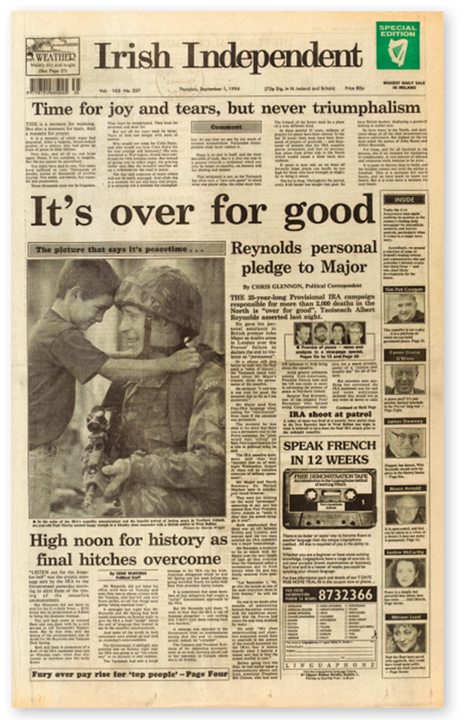
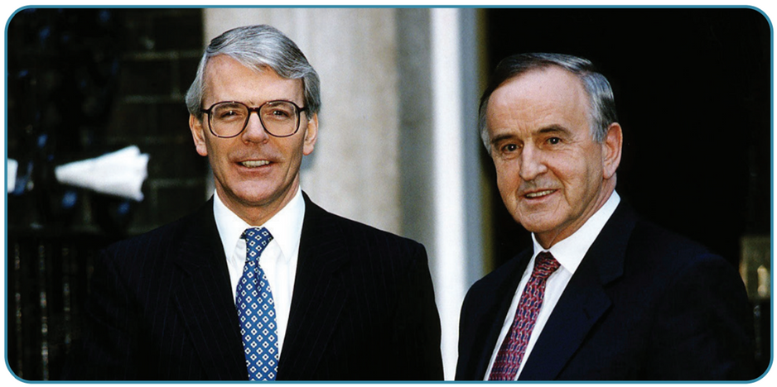
The IRA and Loyalist ceasefires
In the following years, the two governments worked hard to bring parties in Northern Ireland together to agree a new power-sharing relationship, especially under the leaderships of Prime Minister John Major and Taoiseach Albert Reynolds in the early 1990s. They also engaged in secret talks with Sinn Féin and the IRA to try to bring the violence to an end. This process of talks eventually resulted in the Downing Street Declaration in December 1993. This declaration set out the terms for all-party talks on the future of Northern Ireland. Most importantly, only parties committed to peace could be involved. This meant Sinn Féin could only talk part in talks if the IRA ceased its terrorist campaign. On the basis of the Declaration, the IRA called a ceasefire in August 1994. Loyalist groups followed with their own ceasefire in October 1994.
Strand One: The Nature of History
Chapter Thirty: Northern Ireland and The Troubles
Diagram taken from Artefact, 2nd Edition by Eimear Jenkinson and Gregg O'Neill (educate.ie)
@MsDoorley

Slide 51
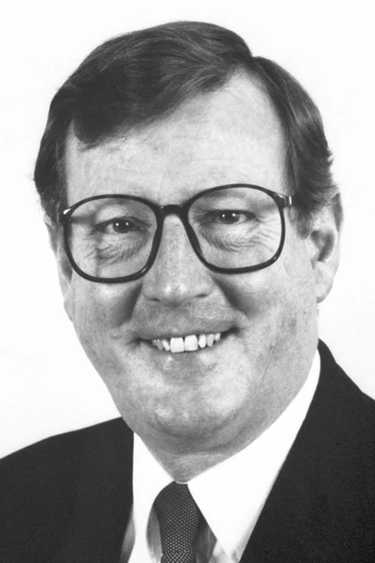
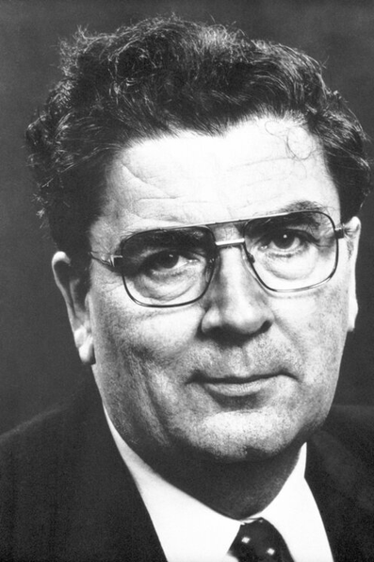
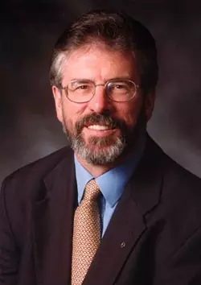
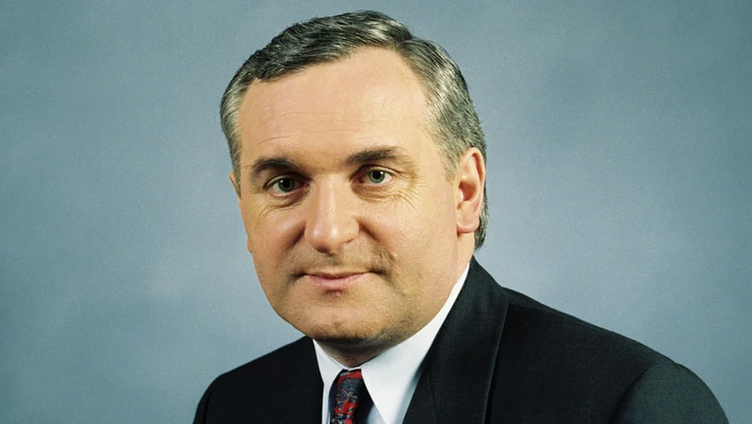
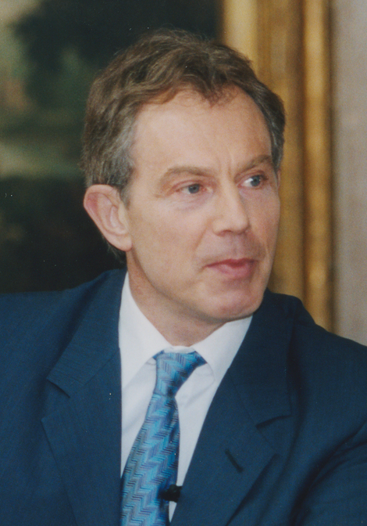
The Good Friday Agreement 1998
After the ceasefires came four years of difficult talks and negotiations. The IRA ceasefire even broken down at one stage over the slow rate of progress. Eventually, direct talks began under the chairmanship of US Senator George Mitchell. The main players were:
Ulster Unionists | SDLP | Sinn Féin | Irish Government | British Government
David Trimble | John Hume | Gerry Adams | Bertie Ahern | Tony Blair
Strand One: The Nature of History
Chapter Thirty: Northern Ireland and The Troubles
Diagram taken from Artefact, 2nd Edition by Eimear Jenkinson and Gregg O'Neill (educate.ie)
@MsDoorley

Slide 52
The Good Friday Agreement 1998
The hardline Unionists, led by Ian Paisley's DUP, refused to engage in talks with Sinn Féin and so did not take part. Just before Easter 1998, the parties and governments reached agreement on the Good Friday Agreement. This was an attempt at a comprehensive deal to secure a sustainable peace for Northern Ireland. Its main terms included:
  Power sharing between all the main political parties
  Cross-border bodies to link the North and South
  That the Republic would give up its constitutional claim on Northern Ireland
  The release of IRA and loyalist prisoners from jail
  Decommissioning (surrendering) of weapons by terrorist groups
  Reform of the RUC and the withdrawal of British troops.
In a referendum on both sides of the border, the agreement was accepted by 71% of Northern Ireland and 94% of the Republic. Putting the agreement into practice was difficult and neither side kept its part of the deal. Despite this, there was never a return to the violence seen during the height of the Troubles. In 2005, the IRA announced the end of its armed campaign.
In 2007, Ian Paisley of the DUP and Martin McGuinness of Sinn Féin - once sworn enemies - were elected as First and Deputy First Minister of Northern Ireland, showing how far Northern Ireland had come far since the end of the Troubles.
Strand One: The Nature of History
Chapter Thirty: Northern Ireland and The Troubles
Diagram taken from Artefact, 2nd Edition by Eimear Jenkinson and Gregg O'Neill (educate.ie)
@MsDoorley

Slide 53
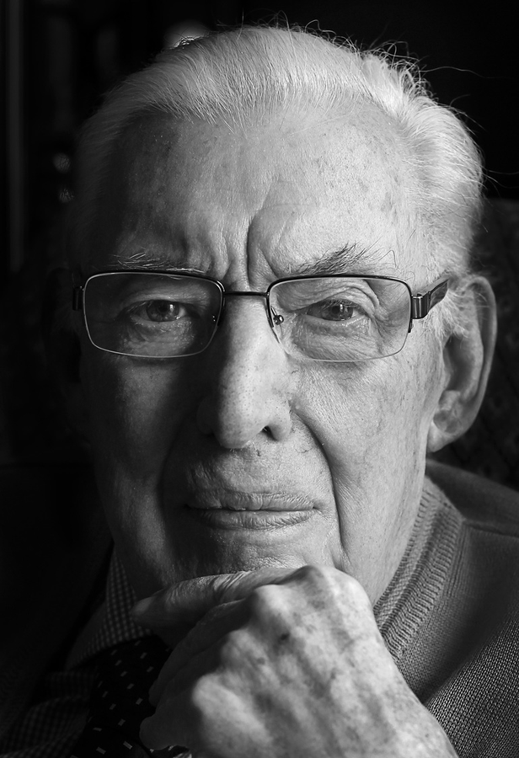
Ian Paisley, 1926-2014
Ian Paisley was the leader of hardline unionists for over 40 years. He became a Protestant evangelical minister at the age of 20. He founded his own church, the Free Presbyterians, and became known for his fiery sermons attacking 'immorality' and Catholicism. In the mid to late 1960s, he led opposition to the civil rights movement and to moderate unionists such as Terence O'Neill. This contribute to the outbreak of the Troubles in the late 1960s. In 1971, Paisley founded the Democratic Unionist Party (DUP), which strongly opposed any compromise with nationalists or power sharing. He helped bring down the Sunningdale Agreement in 1974. He also opposed the Anglo-Irish Agreement of 1985, the peace process and the Good Friday Agreement of 1998. In 2007, after the DUP became the largest unionist party, he agreed to share power with Sinn Féin. He served as First Minister of Northern Ireland from 2007 to 2008, when he retired. He died in 2014 at the age of 85.
Strand Two: The History of Ireland
Chapter Thirty: Northern Ireland and The Troubles
@MsDoorley

Slide 54
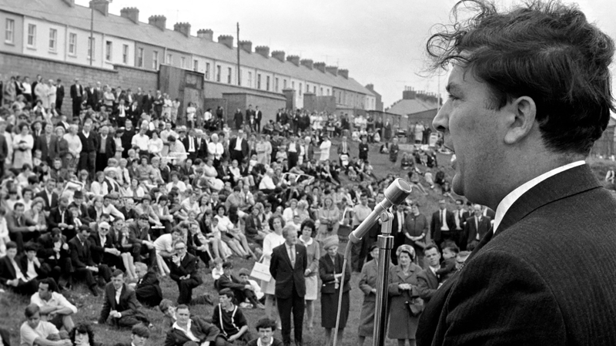
John Hume, 1937-2020
Early Life
John Hume was born in Derry City in 1937. He worked as a teacher and became involved in the local community. He helped found the Derry Credit Union and campaigned for better housing and an university in the city.
Strand Two: The History of Ireland
Chapter Thirty: Northern Ireland and The Troubles
Civil Rights Activist
Hume became involved in the Civil Rights Movement after the failure of his housing and university campaigns. He was a founding member of the NICRA and believed in peaceful means and opposed all forms of violence. He was elected to Stormont in 1969. In 1970, he helped found the SDLP to give a new, peaceful voice to Nationalists. As the violence worsened throughout the early 1970s, he repeatedly rejected the use of force as a means of achieving change.
Diagram taken from Artefact, 2nd Edition by Eimear Jenkinson and Gregg O'Neill (educate.ie)
@MsDoorley

Slide 55
John Hume, 1937-2020
The Search For Peace
As a senior member of the SDLP, he was appointed Minister for Commerce in the Sunningdale Power-Sharing Executive. After the collapse of the Sunningdale Agreement, he began working closely with the Irish government. He became leader of the SDLP in 1979. He also began working with senior leaders in the USA, such as Senator Ted Kennedy and President Ronald Reagan, to get them to put pressure on the British government.
He strongly supported the Anglo-Irish Agreement in 1985, which he played a role in negotiating behind the scenes. He then began holding talks with Gerry Adams, the leader of Sinn Féin. He was criticised for it, as the IRA were still killing people. His work paid off with the IRA ceasefire (1994) and the Good Friday Agreement (1998). The Good Friday Agreement embodied Hume's ideals of a shared Northern Ireland based on equality and respect; ideals that he had argued for since the 1960s. He retired as SDLP leader in 2004.
Strand Two: The History of Ireland
Chapter Thirty: Northern Ireland and The Troubles
Legacy
Along with Ulster Unionist Party leader, David Trimble, Hume was awarded the Nobel Peace Prize in 1998 for their work during the peace process. Hume belongs to the same tradition in Irish history as Daniel O’Connell and Charles Stewart Parnell: men who believed Ireland’s problems could only be resolved peacefully. He died in 2020 at the age of 83.
@MsDoorley
The Search For Peace

Slide 56
Checkpoint pg. 283 (Artefact, 2nd Edition)
  What did the two governments agree in the Anglo-Irish Agreement in 1985?
  What was the Unionist reaction to the Anglo-Irish Agreement?
  What was the Downing Street Declaration?
  When did (a) the IRA and (b) the loyalists call ceasefires?
  Who were the main leaders involved in the talks in the late 1990s?
  What were the main terms of the Good Friday Agreement of 1998?
  Did the Good Friday Agreement enjoy strong public support? Give reasons for your answer.
  How did John Hume contribute to achieving peace in Northern Ireland?
  Describe how John Hume is an example of a leader in the parliamentary tradition of Irish history.
Strand Two: The Nature of History
Chapter Thirty: Northern Ireland and The Troubles
@MsDoorley

Slide 57
1920-2007
Chapter 30
30.7: SUMMARY
30.7: summary
Strand Two: The History of Ireland
@MsDoorley

Slide 58
In this chapter, we have learned that...
  Northern Ireland was established in 1921 after partition; the Unionist Party represented the majority-Protestant population and actively excluded Catholics from positions of power.
  Catholics were discriminated against in housing, employment and politics through the use of gerrymandering and multiple votes.
  The welfare state benefitted the Catholics through improved education and by the 1960s, new PM Terence O’Neill started to reach out to Catholics but failed to follow through with action.
  Catholics set up the NICRA to campaign for civil rights through peaceful means but were quickly banned and attacked, attracting violence.
  The British Army was sent into Northern Ireland after the Battle of the Bogside (1969) and quickly became targets for the IRA.
  Following Bloody Sunday (1972), the British government suspended the Stormont Parliament. The 1973 Sunningdale Agreement aimed to get the moderates of nationalist and Unionist sides to share power but collapsed due to Unionist opposition.
  Violence continued throughout the 1970s and 1980s, progressively getting worse which prompted the British and Irish governments to work together to find ways to end the fighting. This lead to the Anglo-Irish Agreement (1985) and the Downing Street Declaration (1993).
  The IRA and loyalists called ceasefires in 1994 with talks beginning once both had put their guns down.
  Eventually, the Good Friday Agreement was signed between the two governments and the main Northern Irish political parties in 1998; during the course of the Troubles, some 3,500 people were killed.
Strand Two: The History of Ireland
Chapter Thirty: Northern Ireland and The Troubles
@MsDoorley

Slide 59
Reflecting on... The Troubles
  The long relationship between Britain and Ireland has often been one of conflict. The violence during the three decades of the Troubles should be seen in the historical context of religious discrimination dating back to the plantations of the 1600s and the advent of physical force nationalism in 1798.
  Northern Ireland was, and is, a divided society: each community feels its grievances against the other. Three decades of violence did little to improve this but the failure of that violence to change the status of Northern Ireland did highlight the futility of terrorism.
Strand Two: The History of Ireland
Chapter Thirty: Northern Ireland and The Troubles
@MsDoorley

Slide 60
SEC Examination Questions
2021 SEC Sample Q10
2023 SEC Q7
Strand Two: The History of Ireland
Chapter Thirty: Northern Ireland and The Troubles
@MsDoorley

Slide 61
Project
Guidelines:
  Length: The depth of your project should reflect about 2-3 weeks of work.
  Sources: Use at least three different sources for your research. These can be books, scholarly articles, or reputable online resources.
  Citations: All information and images that are not your own should be properly cited.
  Mediums: You may choose to present your project in one of the following ways:
    Poster: Your poster should be informative and visually engaging.
    Minecraft or Lego Model: If choosing this option, please also include a brief report explaining your model.
    Painting/Drawing: Your artwork should be accompanied by a description.
    Recycled Materials: Create your model using recycled materials and provide an explanation of your creative process.
Assessment:
Your projects will be assessed based on:
  Research and Content
  Creativity and Presentation
  Understanding of Context
  Adherence to Guidelines
Strand Two: The History of Ireland
Chapter Thirty: Northern Ireland and The Troubles
@MsDoorley

Slide 62
Project
Historical Sites
Historical Figures
Bogside, Derry, Northern Ireland
Maze Prison, Lisburn, Northern Ireland
Shankill Road, Belfast, Northern Ireland
Guildhall, Derry, Northern Ireland
Omagh Memorial Garden, Omagh, Northern Ireland
Terence O’Neill
Brian Faulkner
Ian Paisley
Gerry Fitt
John Hume
Bernadette Devlin
Austin Currie
Gerry Adams
Martin McGuinness
Bobby Sands
Margaret Thatcher
Garret Fitzgerald
David Trimble
Tony Blair
Bertie Ahern
Betty Williams
Mairead Corrigan
Strand Two: The History of Ireland
Chapter Thirty: Northern Ireland and The Troubles
@MsDoorley

